Slide 1




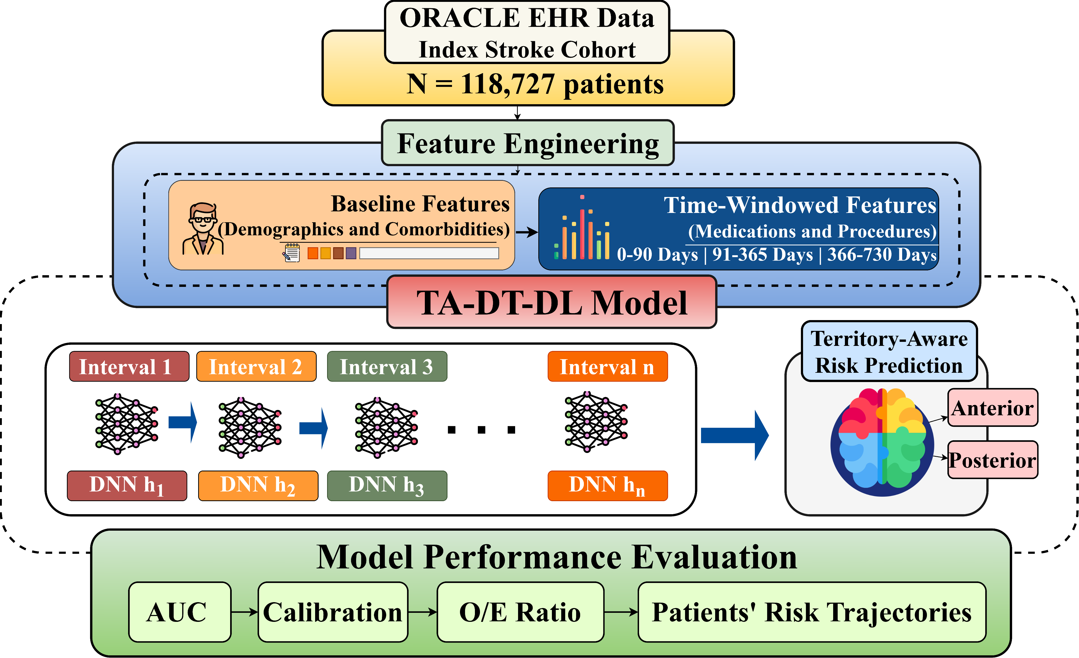
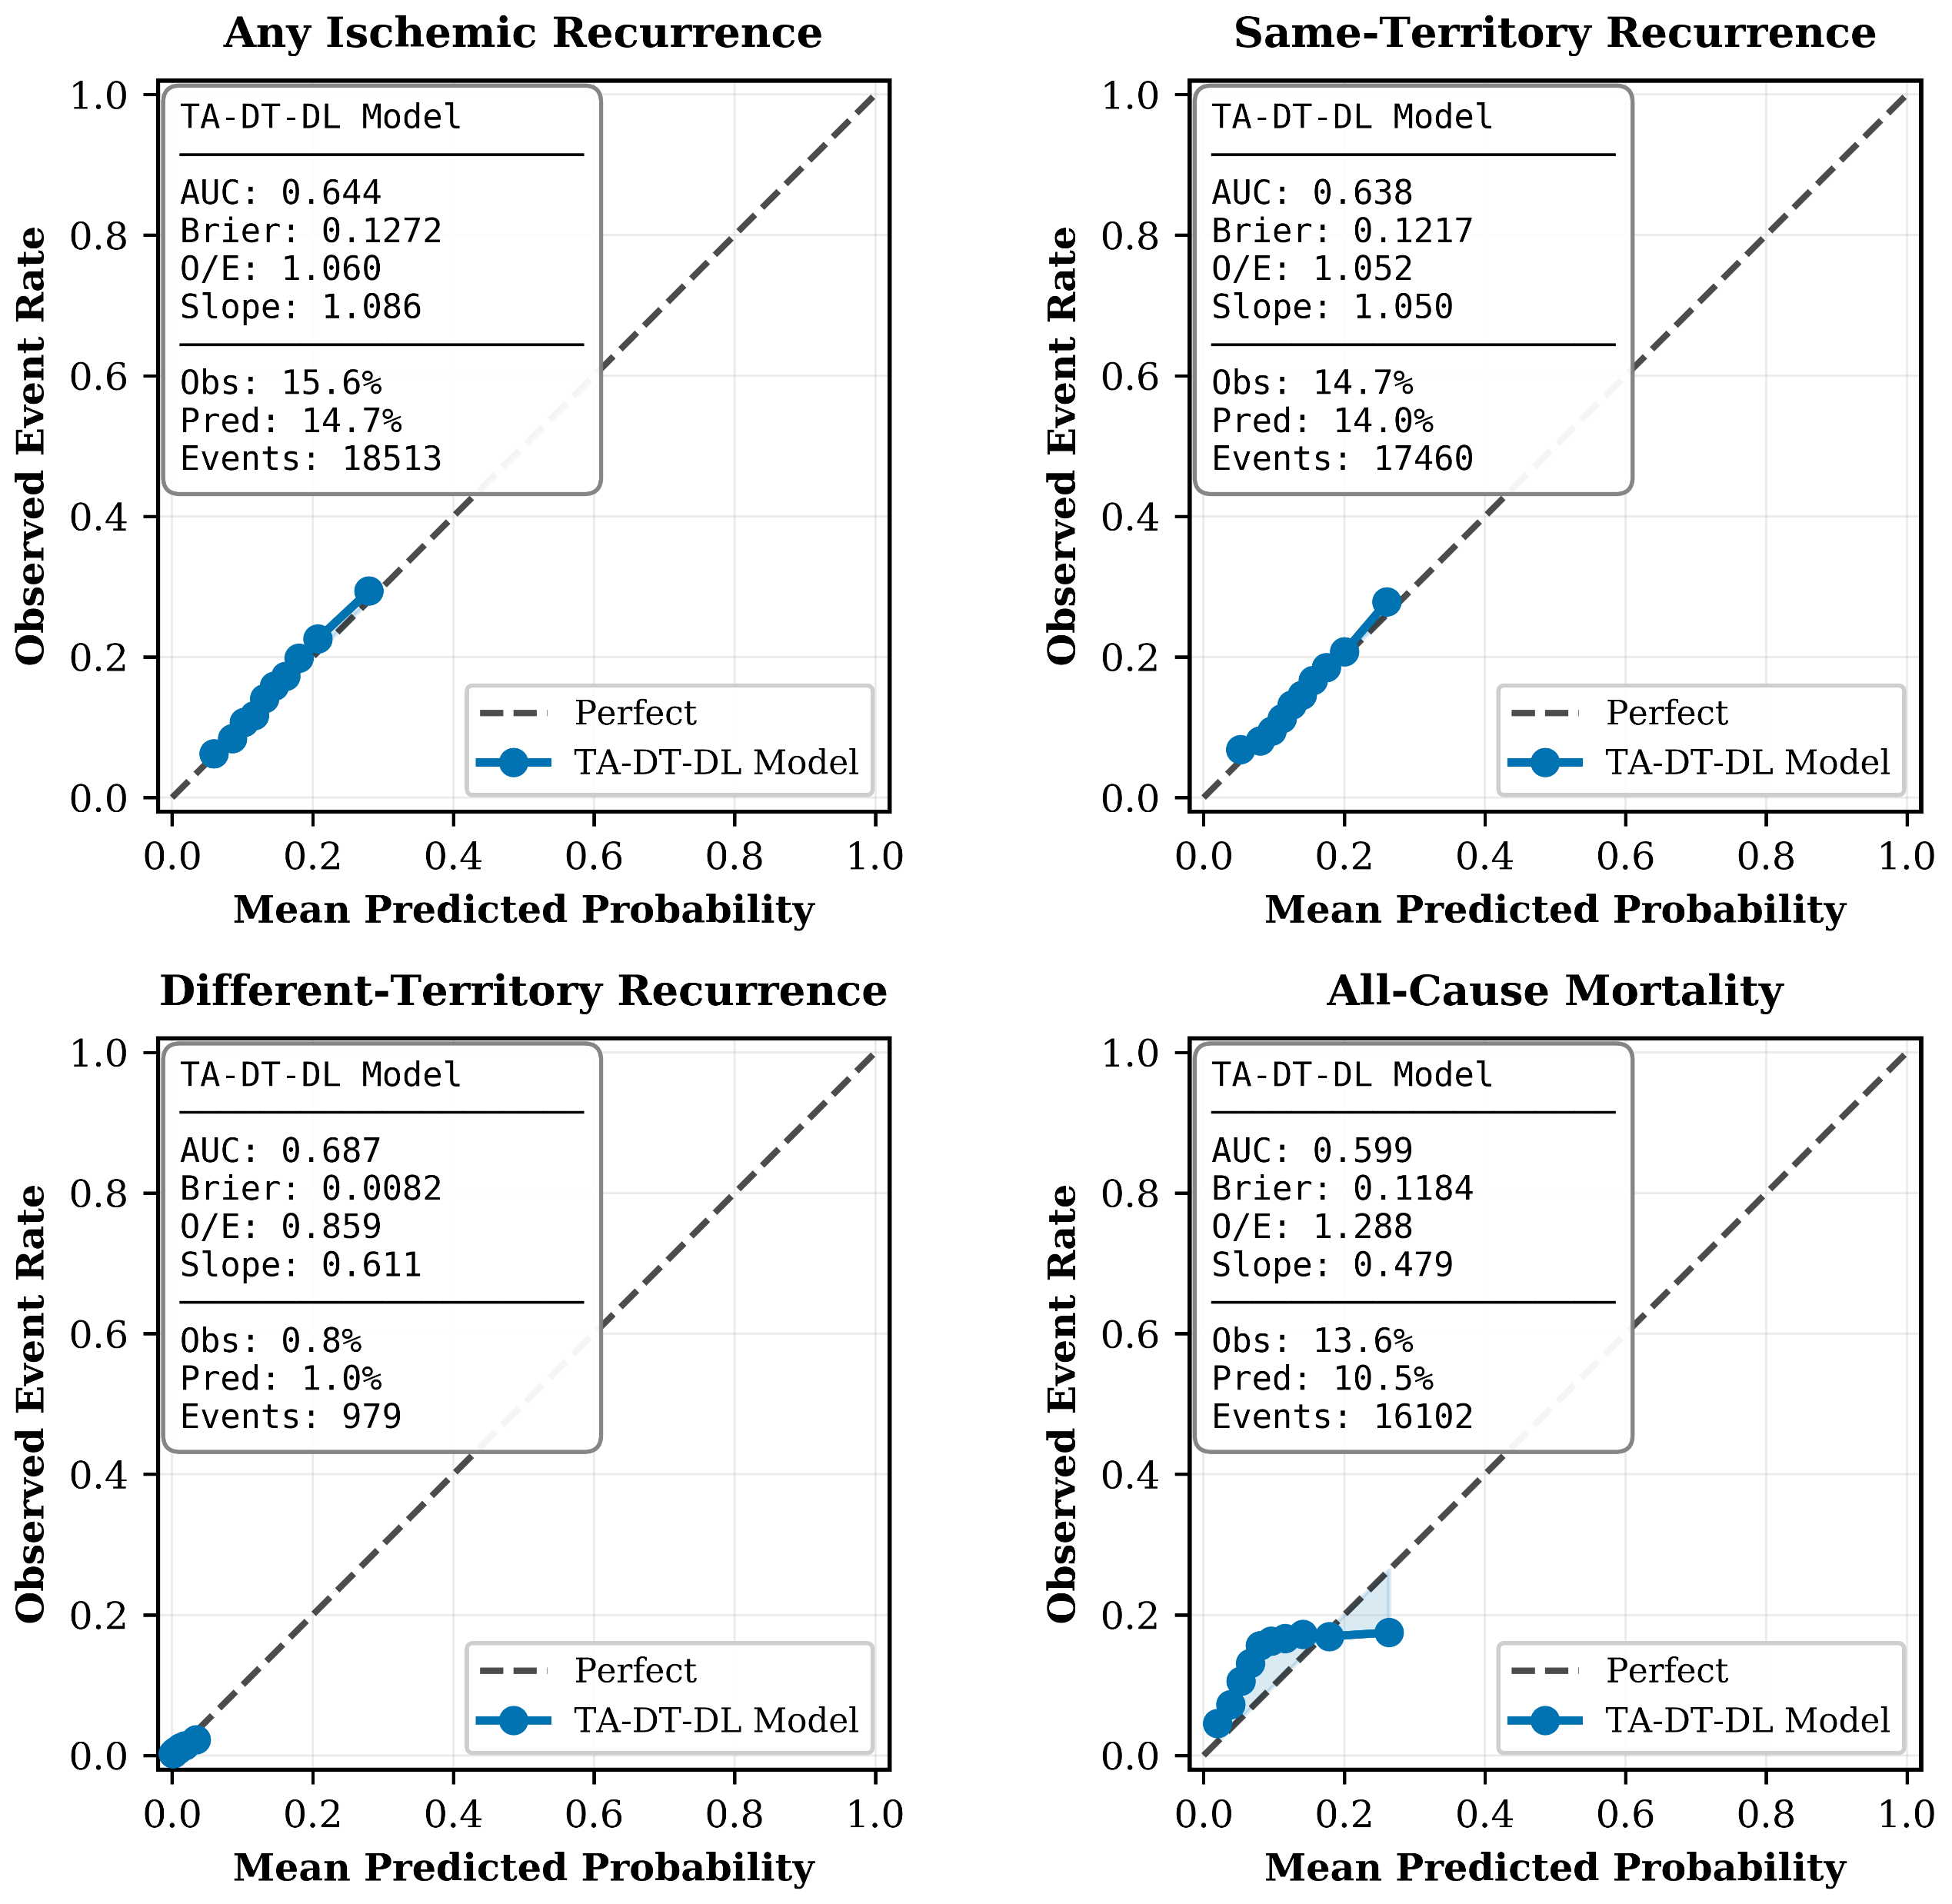
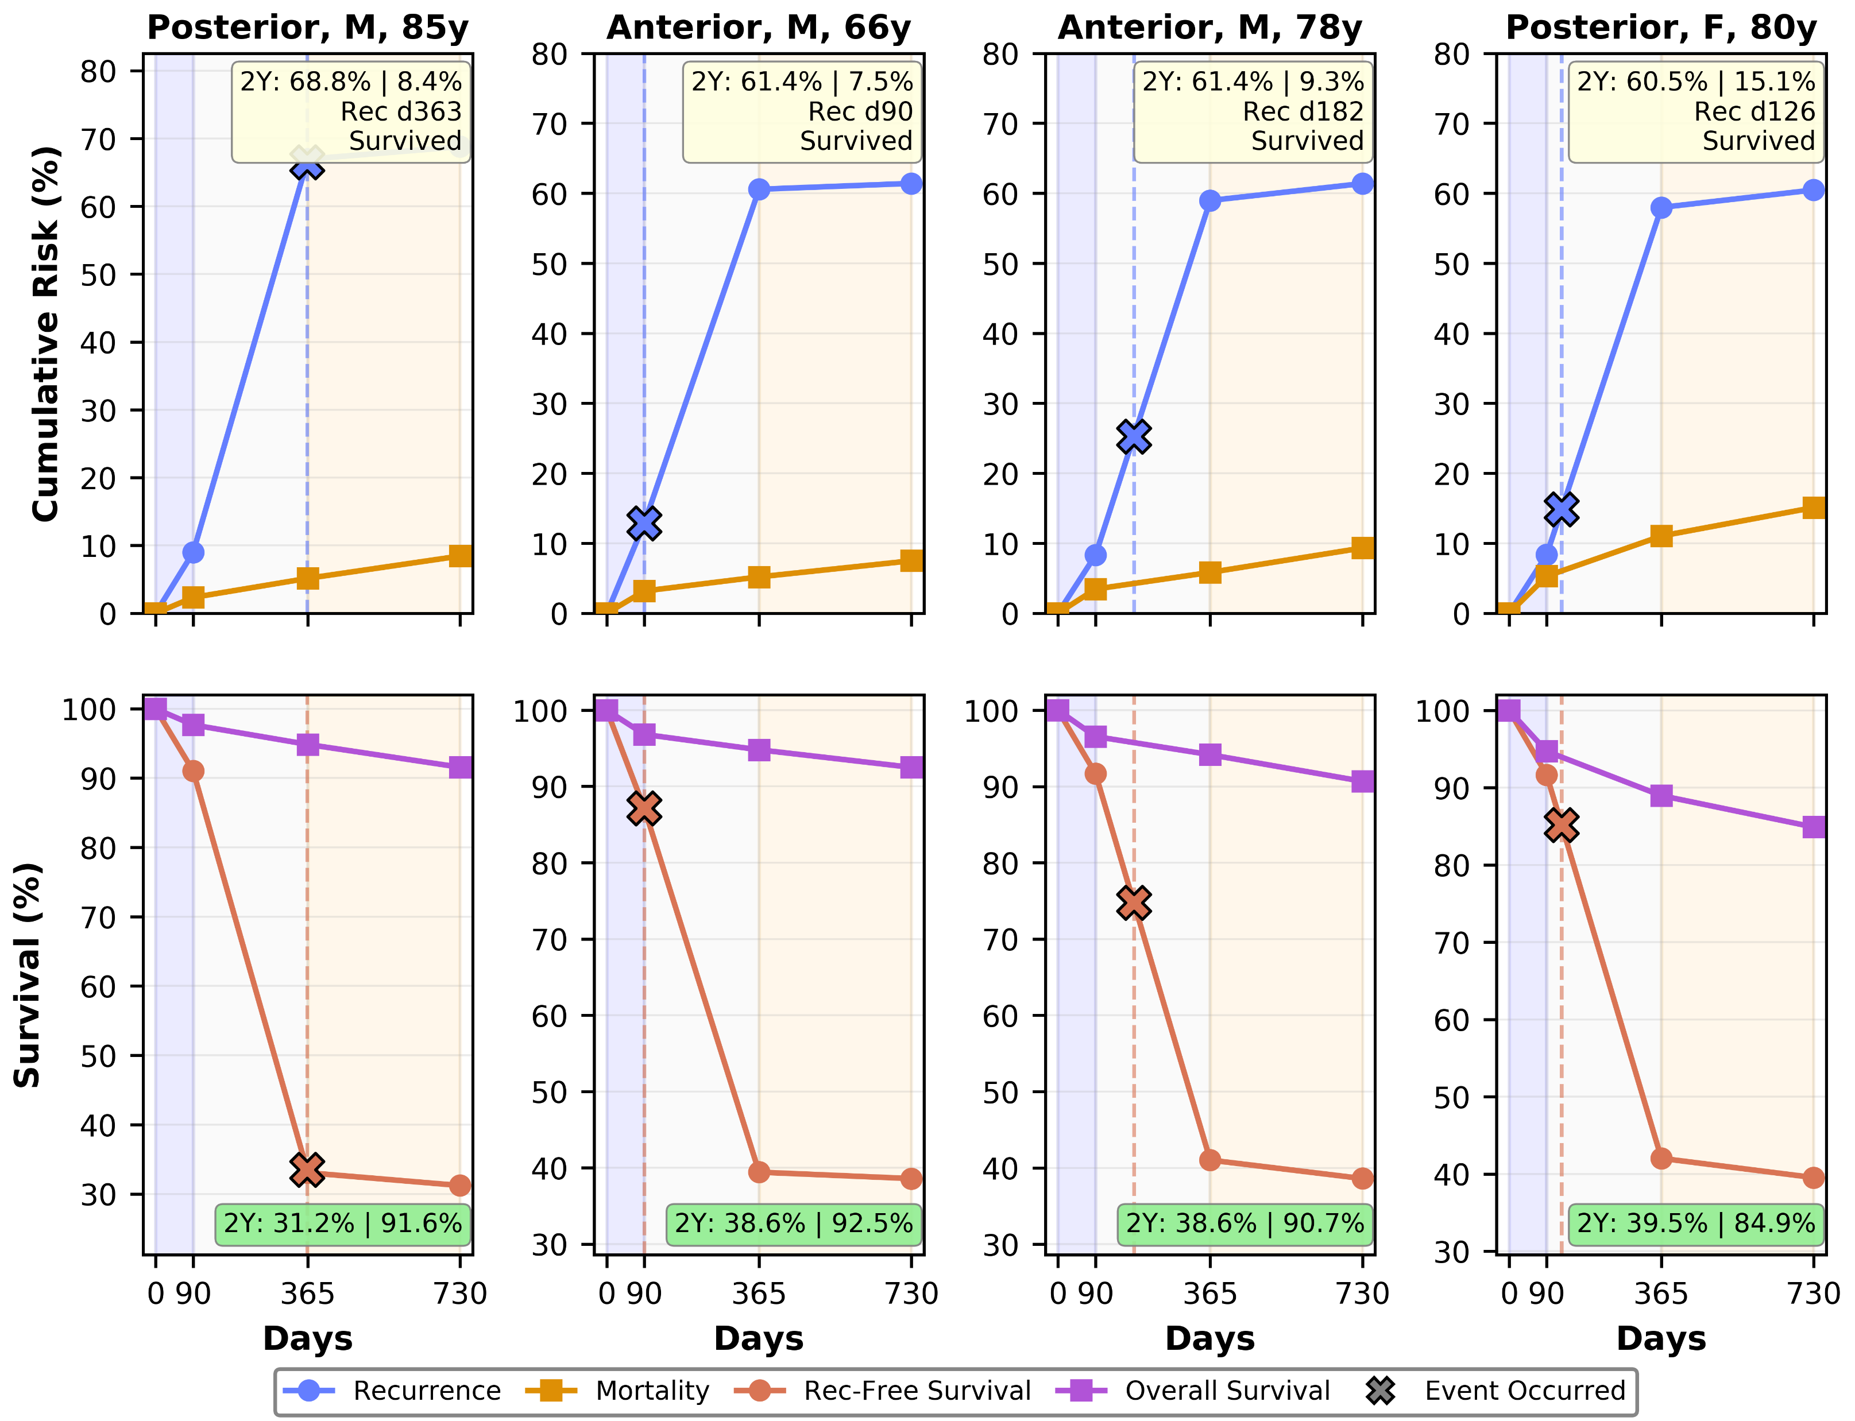

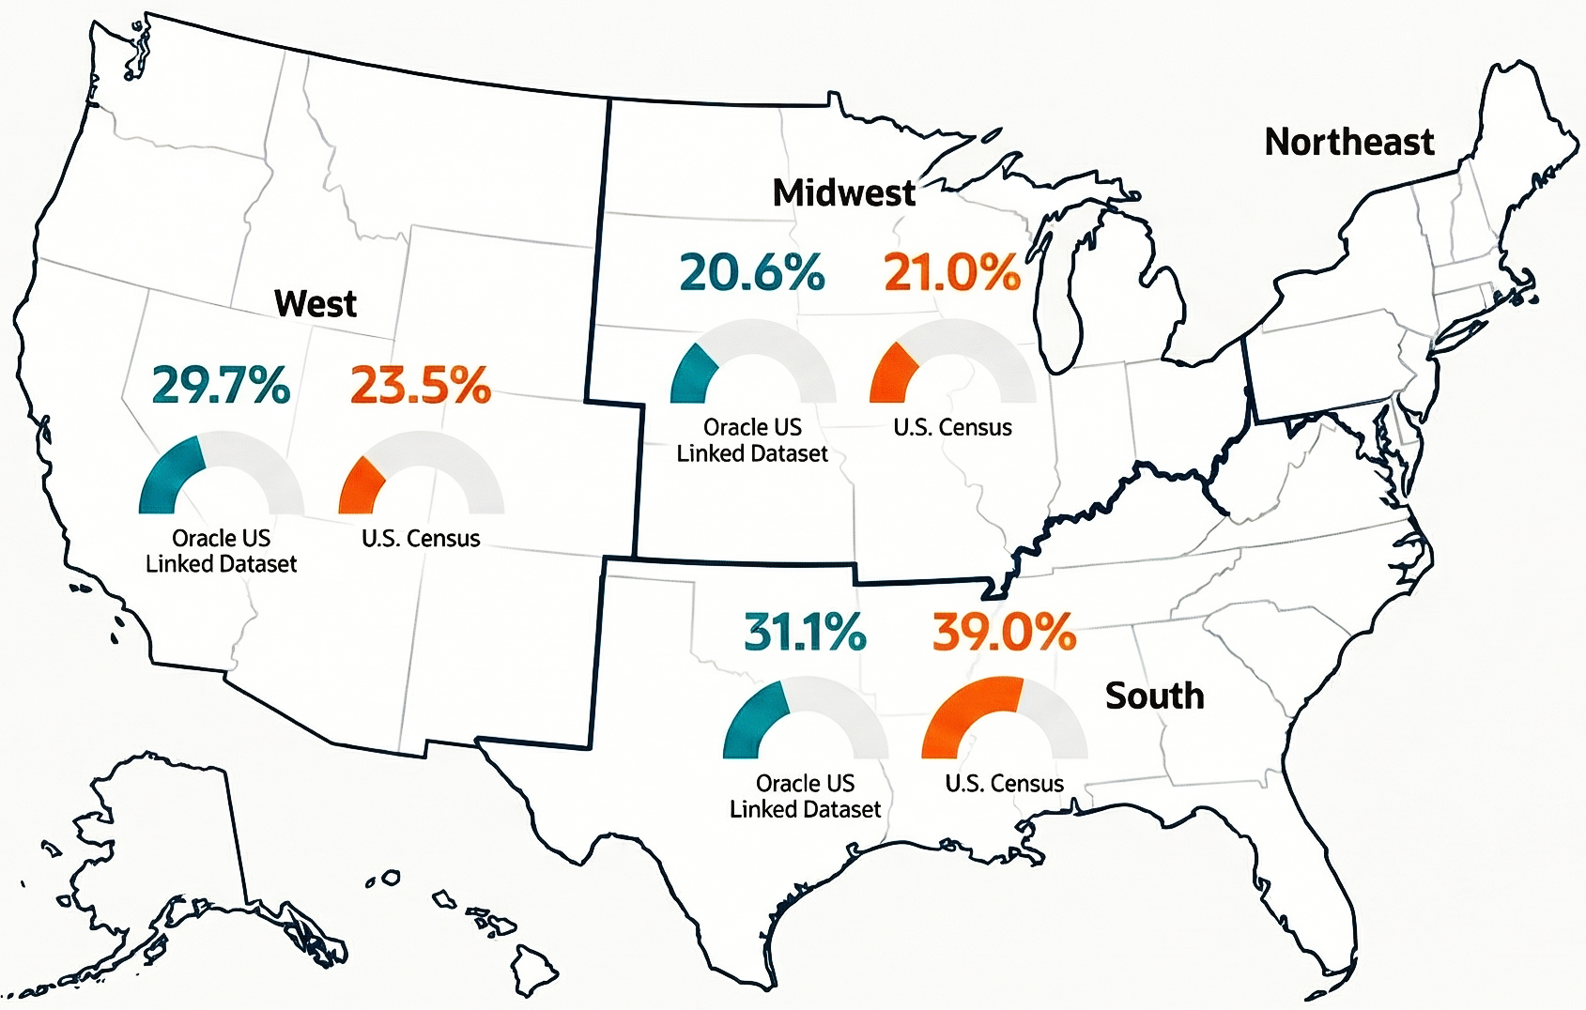
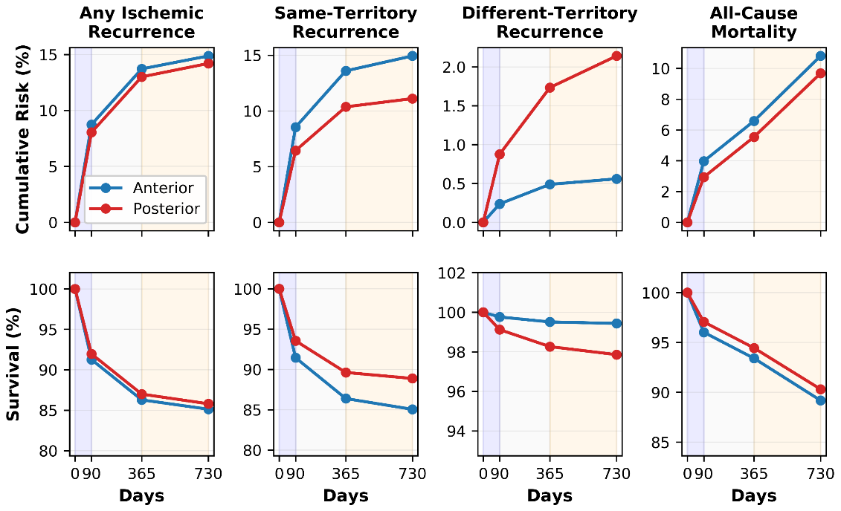
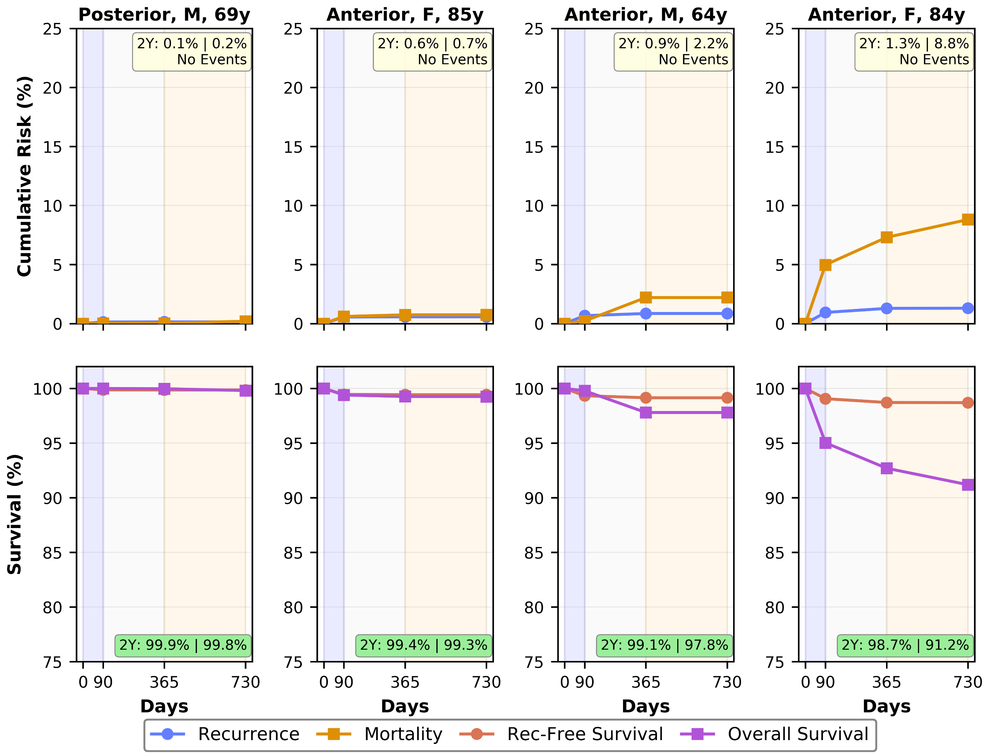

Territory-Aware Discrete-Time Deep Learning for Ischemic Stroke Recurrence and Mortality Risk Prediction with Patients Risk Trajectories Using Longitudinal EHR Data
Samrat Kumar Dey¹, Adnan I. Qureshi², and Chi-Ren Shyu³
¹MU Institute for Data Science and Informatics; ²Department of Neurology, ³Department of Computer Science & Engineering, University of Missouri, Columbia, MO, USA
  Motivation
  TA-DT-DL Framework
  Calibration
Ischemic stroke is a leading cause of death and long-term disability worldwide [1]. Accurate post-stroke risk prediction is critical for guiding secondary prevention and personalized care.
10–20%
of stroke patients experience another stroke within 2 years [2]
>15%
die within 2 years of their initial
event [2]
  Gaps in Current Approaches
1
Binary endpoints
Fixed timepoint classification obscures temporal risk dynamics [3]
2
Pooled vascular territories
Fig. 3. Calibration of TA-DT-DL model for stroke recurrence and mortality across four outcomes.
Anterior vs. posterior recurrence patterns are not modeled [4-5]
Fig. 1. Proposed architecture of the TA-DT-DL framework.
  Performance
3
Cox/PH assumptions break down
  Methods
Table 2. Performance comparison of TA-DT-DL with baseline, tabular, and deep models.
Real-world cohorts show nonlinear, time-dependent effects that violate proportional-hazards assumptions [6,7].
Discrete-Time Intervals
Performance Metric | TA-DT-DL | RNN | LSTM | Cox/LR | XGBoost
MAE (percentage points) | 1.2 | 1.4 | 1.44 | 8.99 | 38.04
Deviation from perfect calibration (O/E = 1.0) | 0.132 | 0.241 | 0.212 | 0.419 | 0.786
Mean AUC | 0.642 | 0.730 | 0.651 | 0.743 | 0.763
Well-calibrated outcomes (O/E 0.90–1.10) | 4/8 (50%) | 1/8 (12.5%) | 2/8 (25%) | 2/8 (25%) | 0/8 (0%)
Acceptable outcomes (O/E 0.80–1.20) | 6/8 (75%) | 5/8 (62.5%) | 5/8 (62.5%) | 3/8 (37.5%) | 0/8 (0%)
Best performing outcomes | 7/8 (87.5%) | 1/8 (12.5%) | 0/8 (0%) | 2/8 (25%) | 0/8 (0%)
I₁
0–90 days
I₂
91–365 days
I₃
366–730 days
  Contributions
Early Phase
Subacute Phase
Late Phase
1
Any ischemic stroke recurrence
Discrete-Time Hazard
Territory-Aware Discrete-Time Framework
$$h_{i}^{(k)}=P(T_{i} ε{ W}_{k}|T_{i}≥W_{k}, X_{i}^{\left(k\right)})$$
Models' recurrence and mortality as interval-specific hazards across three clinically meaningful phases
(0–90, 91–365, 366–730 days), explicitly incorporating vascular territory.
2
Same-territory recurrence
$${\hat{h}}_{i}^{(k)}=σ\left(f_{θ(k)}\left(X_{i}^{(k)}\right)\right)$$
Probability of event in interval k, conditional on survival to start of k.
KEY INSIGHT
Different-territory recurrence
All-cause mortality
(2-year)
TA-DT-DL achieves the lowest calibration error (1.2 pp) and the most stable O/E range, discrimination is not enough for clinical deployment.
Time-Resolved Risk Stratification
3
4
  Patient-Level Trajectories
Translates continuous model predictions into clinically interpretable risk categories (Low, Moderate, High, Very High) and patient-level trajectories.
  Observed Outcome
Table 1. Territory-Stratified 2-Year Observed Outcomes (95% CI)
Large-Scale Real-World Evaluation
Outcome | Anterior (n = 88,697) | Posterior (n = 30,030)
Any Recurrence | 15.7% (15.5–16.0) | 15.1% (14.7–15.6)
Same-Territory | 15.3% (15.1–15.6) | 12.9% (12.5–13.3)
Different-Territory | 0.5% (0.5–0.6) | 1.7% (1.5–1.8)
Mortality | 14.4% (14.1–14.6) | 11.2% (10.9–11.6)
Survived | 85.6% (85.4–85.9) | 88.8% (88.4–89.1)
118,727 ischemic stroke patients across 149 U.S. health systems [8]. Evaluated discrimination, calibration, O/E agreement, and individual-level trajectories.
  Data Descriptions
  Results
Fig. 4. Individual high-recurrence risk trajectories with illustrative patient-level cases.
  Vascular Territory
Fig. 5. Individual low-recurrence risk trajectories with illustrative patient-level cases.
ACIS · Anterior Circulation
  Clinical Significance
Vascular source: Internal carotid arteries
Cohort: n = 88,697 (74.7%)
Key clinical pattern
Higher mortality (14.4%) and same-territory recurrence (15.3%)
Personalized Follow-Up
Territory Specific Care
Subacute-Phase Vigilance
Reliable Probabilities
Fig. 2. Territory-specific interval-wise predicted risk and survival trajectories.
  Conclusion
PCIS · Posterior Circulation
ACIS
PCIS
BOTH
Integrates vascular territory with interval-specific hazards over 2 years.
Most reliable calibration (1.2 pp error), critical for clinical deployment.
Identifies 91–365-day subacute window as critical recurrence escalation period.
Vascular source: Vertebrobasilar system
Cohort: n = 30,030 (25.3%)
Key clinical pattern
~3× higher different-territory recurrence
(1.7% vs 0.5%)
Steeper rise in same-territory recurrence and mortality
Markedly higher different-territory recurrence (~3×)
Sharpest rise occurs in the 91–365-day subacute window
  REFERENCES
Subacute window (91–365 days) shows the steepest rise in recurrence and mortality across both territories.
[1] Feigin VL et al. Global burden of stroke and risk factors, 1990–2019. Lancet Neurol. 2021.
[2] Aarnio K et al. Long-term mortality after first-ever and recurrent stroke in young adults. Stroke. 2014.
[3] Xu L, Zhou B, Xu Y. Evaluating Cox proportional hazards model limitations in cardiovascular research. Eur Stroke J. 2025.
[4] Jiang N, Wu Y, Li C. Limitations of Cox proportional hazards model in cardiovascular research. Cardiovasc Diabetol. 2024.
[5] Karvelas N et al. Long-term outcomes after posterior circulation stroke. Eur Stroke J. 2025.
[6] Zürcher E et al. Differences in anterior vs posterior circulation ischemic stroke outcomes. J Stroke Cerebrovasc Dis. 2019.
[7] Issaiy M et al. Machine learning and deep learning in stroke medicine: systematic review. J Neurol. 2024.
[8] Oracle Health. Real-world data platform. 2025.
  From the Intelligent Data Analytics and Quantum (iDAQ) Lab

